Slide 1
FIELD PROJECT
Topic : Online Movie Ticket Booking
BATCH-09
231FA04335- T. Vanaja
231FA04801- B. Harshith
231FA04G18- Abhishek Kumar
231FA04G37-Abhishek Kumar Giri

Slide 2
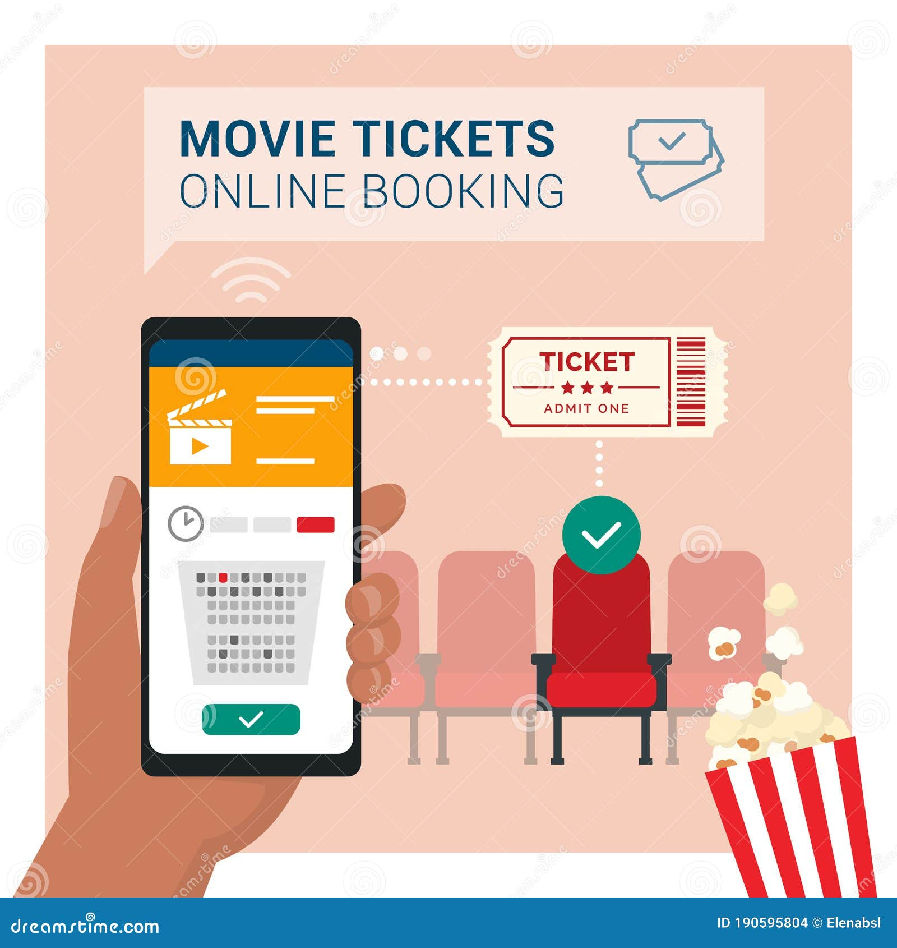
Introduction to Online Movie Ticket Booking
Online movie ticket booking simplifies the process of purchasing tickets from the comfort of home.
It allows users to browse showtimes and select seats without physical lines at theaters.
This presentation will cover the essential features of an online movie ticket booking system
Notes:
Image source: https://thumbs.dreamstime.com

Slide 3
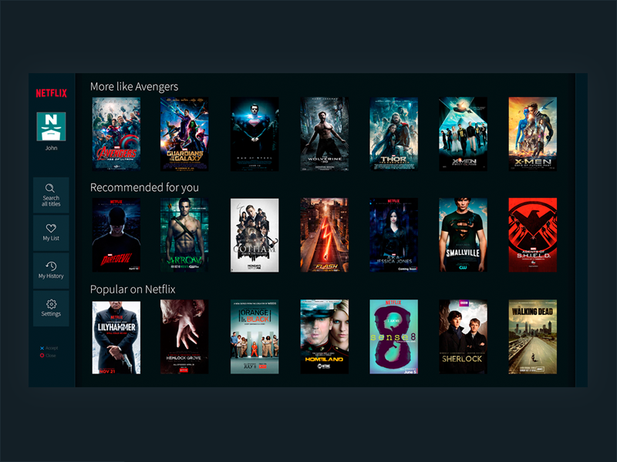
User Features
Movie Search & Filters
Users can search for movies by name, genre, language, rating, or location. Filters help refine choices based on date, cinema, or showtime.
Showtime & Theater Selection
Displays available theaters and showtimes based on user location or preference. Allows users to select a specific cinema chain or nearby theater.
Notes:
3

Slide 4

Interactive Seat Selection
An interactive seat selection tool enables users to choose their desired seats in real-time.
This feature should clearly indicate available, reserved, and premium seating options.
Providing a visual representation of the theater layout enhances clarity and ease of use.
Notes:
4

Slide 5
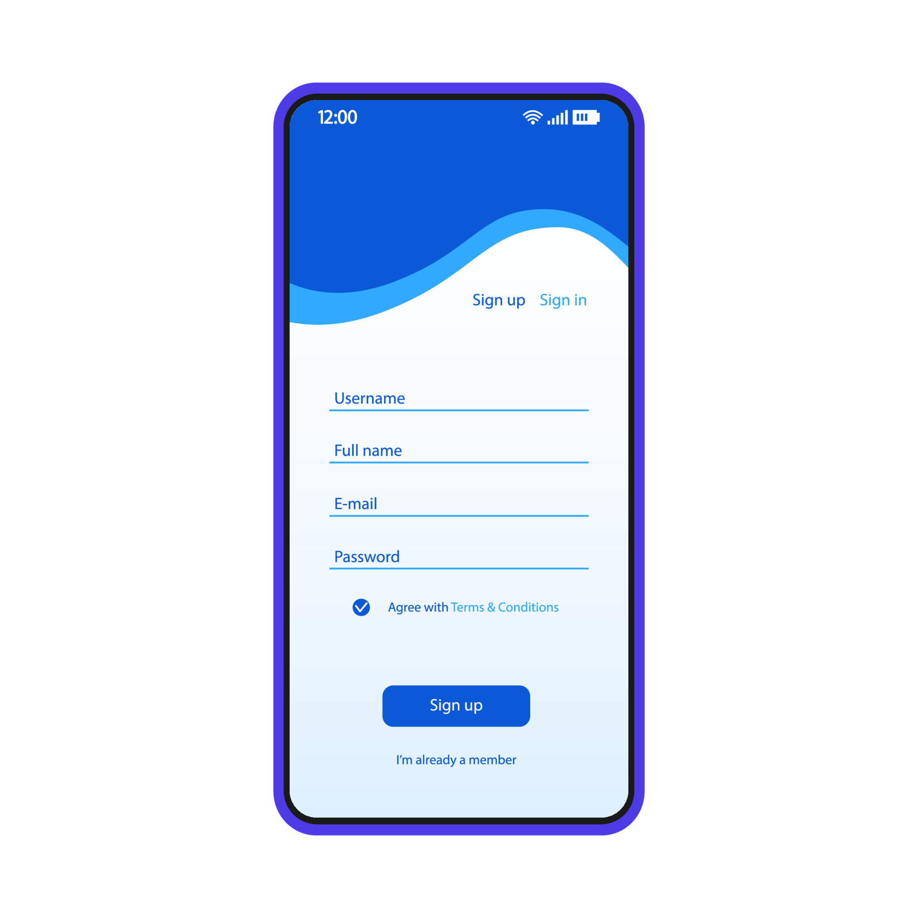
User Registration & Login
Users can sign in to their accounts for a personalized experience, including saved preferences.
A registration option is essential for new users to create an account and access exclusive features.
Secure authentication methods must be incorporated to protect user data.
Account creation via email, phone, or social media.
Login options for personalized recommendations and booking history.
Notes:
6

Slide 6
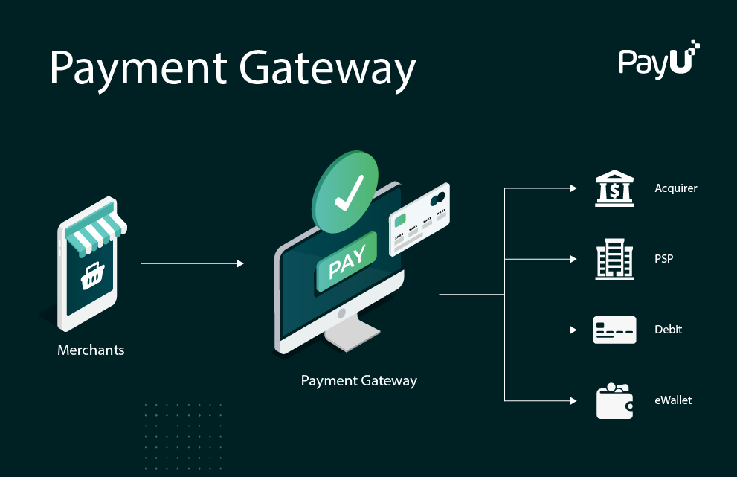
Payment Gateway Integration
A secure payment gateway is crucial for processing transactions safely and efficiently.
Users should have multiple payment options, including credit/debit cards and digital wallets.
Clear confirmation messages and ticket details should be provided upon successful payment.
Notes:
Image source: https://corporate.payu.com

Slide 7
Booking History & Cancellation
Booking History
Users can view past bookings, rebook tickets, or cancel if allowed.
Refund Policies
Refund policies based on theater rules.
Notes:
7

Slide 8
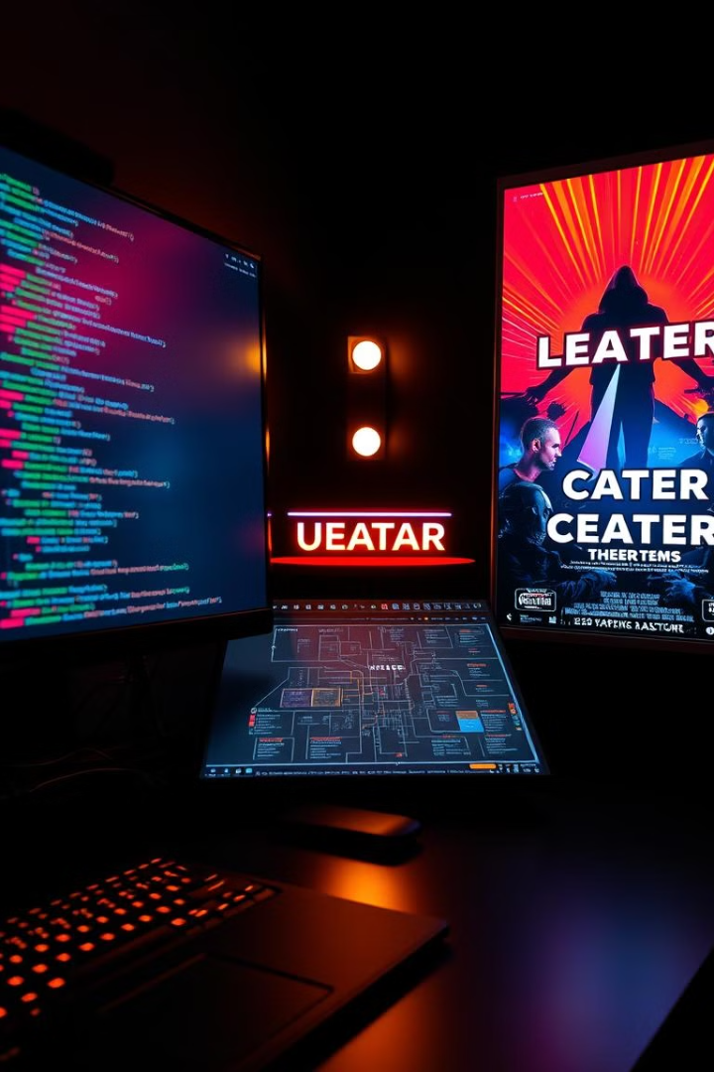
Technical Implementation
HTML Structure
CSS Styling
Each page (e.g., index.html, movies.html, booking.html, contact.html) is structured as follows: Header, Navigation Bar, Movie Listings, Footer.
The stylesheet enhances the UI with a modern, responsive design that adjusts for mobile, tablet, and desktop users. Card-based movie display with hover effects for additional movie details.
JavaScript Functionalities
Dynamic Seat Selection, Cart & Booking Management, Banner Slider, Showtime Filtering, Payment Integration.
Notes:
8

Slide 9
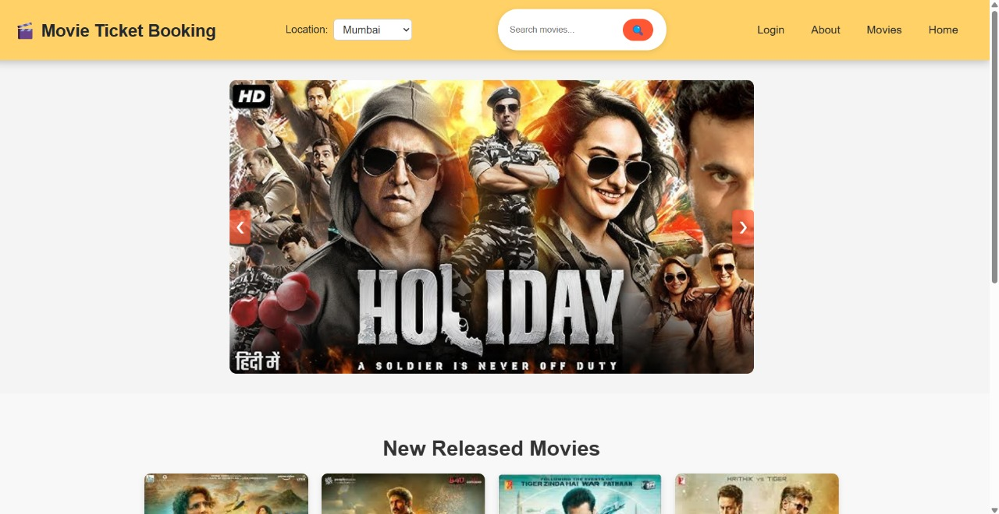
OUTPUT:

Slide 10
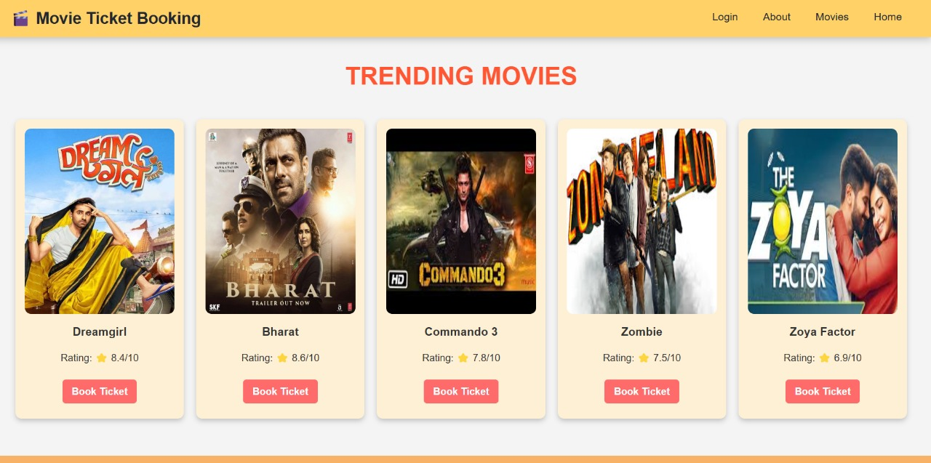

Slide 11
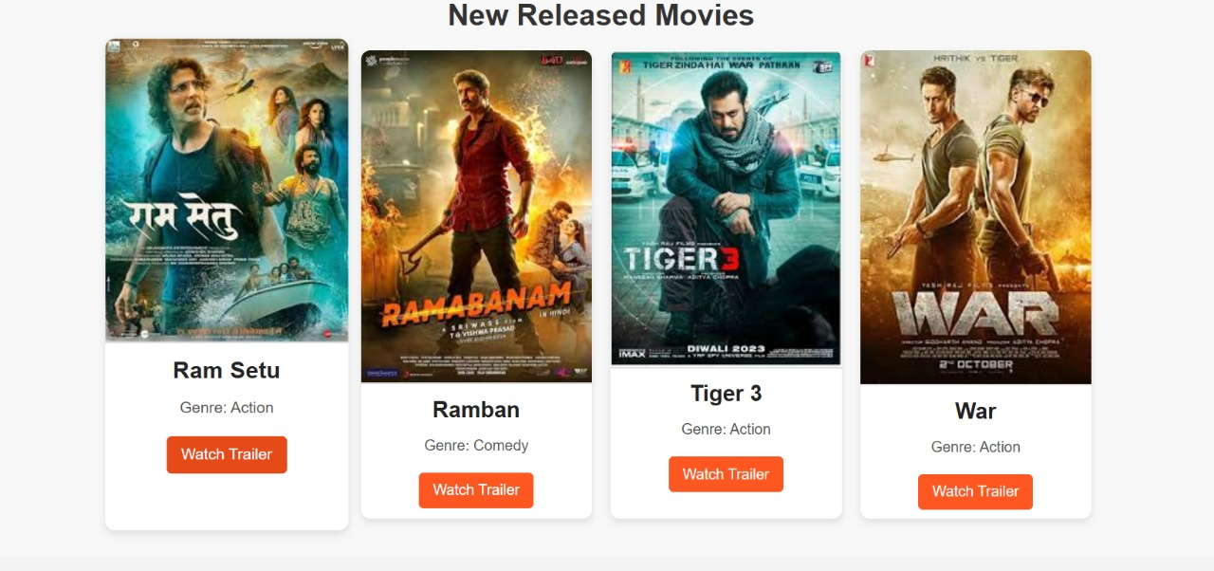

Slide 12
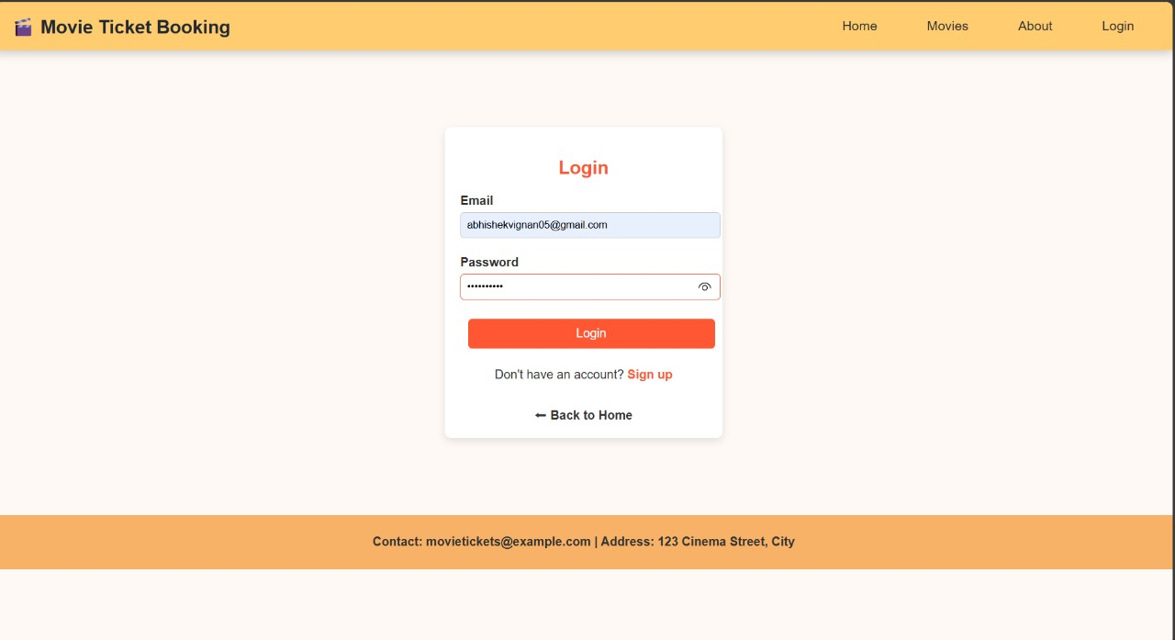

Slide 13
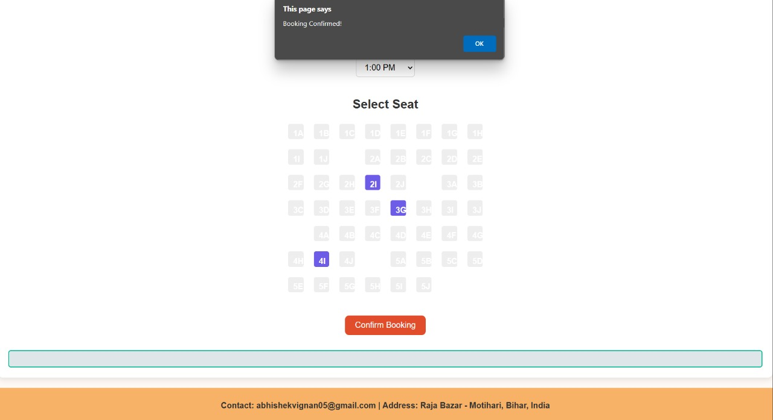

Slide 14
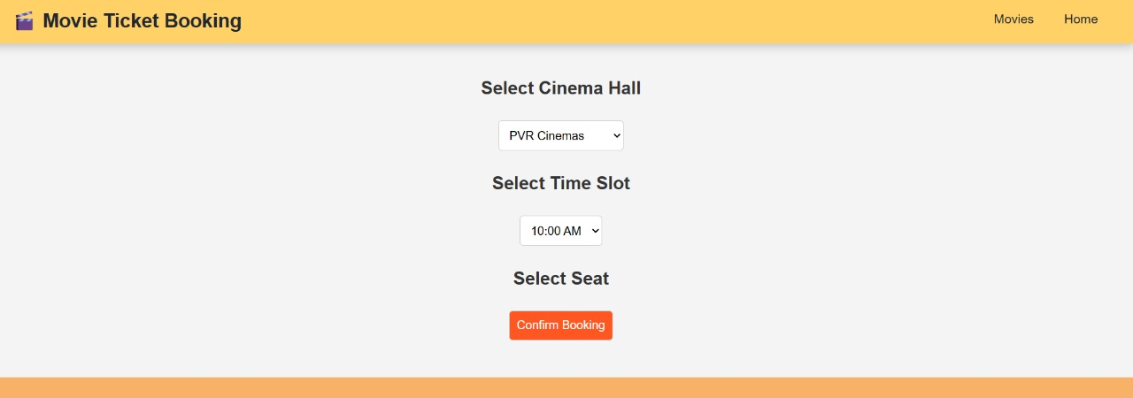

Slide 15

THANK YOU

